Slide 1
Capstone Engagement
Assessment, Analysis, and Hardening of a Vulnerable System

Slide 2
Table of Contents
This document contains the following sections:
01
Network Topology
02
Red Team: Security Assessment
03
Blue Team: Log Analysis and Attack Characterization
Hardening: Proposed Alarms and Mitigation Strategies
04

Slide 3
Network Topology
3

Slide 4
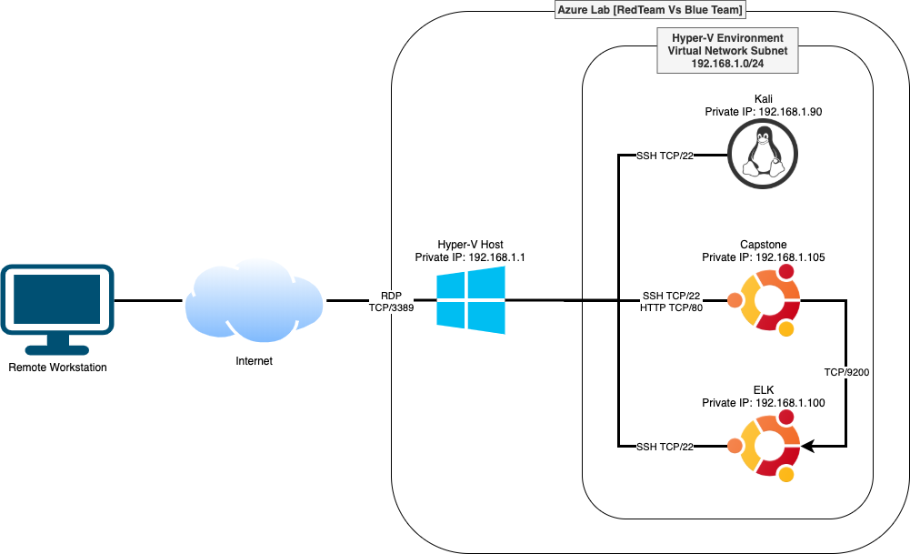
Network Topology
Network
Address Range: 192.168..1.1 ~ 192.168.1.254
Netmask: 255.255.255.0
Gateway: 192.168.1.1
Machines
IPv4: 192.168.1.90
OS: Kali Linux 2020.1
Hostname: Kali
IPv4: 192.168.1.100
OS: Ubuntu 18.04 LTS
Hostname: ELK
IPv4: 192.168.1.105
OS: Ubuntu 18.04 LTS
Hostname: capstone (server1)

Slide 5

Red Team
Security Assessment
5

Slide 6
Recon: Describing the Target
Nmap identified the following hosts on the network:
Hostname | IP Address | Role on Network
Gateway | 192.168.1.1 | Gateway, Hyper-V Host
Kali | 192.168.1.90 | Pentester
ELK | 192.168.1.100 | SIEM
Capstone (Server1) | 192.168.1.105 | Webserver, Vulnerable Target)

Slide 7
Vulnerability Assessment
The assessment uncovered the following critical vulnerabilities in the target:
Vulnerability | Description | Impact
Network vulnerable to port scan | Finding an active port on a host and exploit a known vulnerability of that service | Able to locate the active port of Capstone and obtain webserver directory listing and structure.
Hidden folder vulnerable to unauthorized access | Website contains confidential accessing information to the public. | Able to obtain webserver secret folder location is vulnerable to brute force attack
Password vulnerable to brute force attack | Gain access to a restricted resource by using the most commonly used usernames and passwords | Able to retrieve Ashton’s password by using Hydra
WebDAV vulnerable to reverse shell attack | Let the attacker’s machine run shell script on the target’s machine | Able to upload paul.php to WebDav and open remote session to run shell commands locally

Slide 8
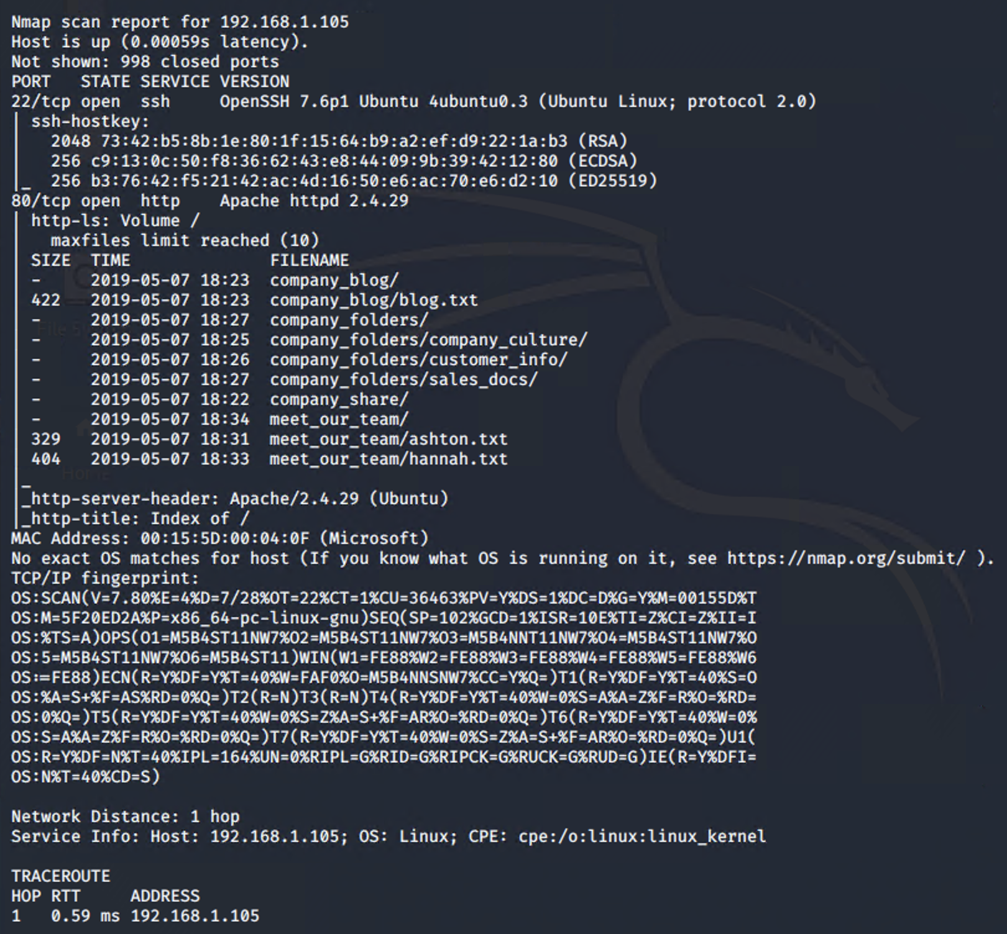
Exploitation: [Network Port Scan]
01
02
03
Tools & Processes
Tools: nmap
Command:
nmap -A 192.168.1.1/24
Achievements
Able to obtain capstone’s active ports and web directory listings

Slide 9
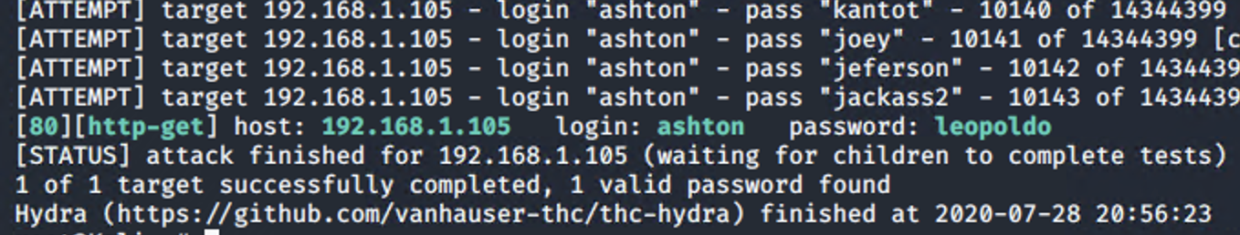
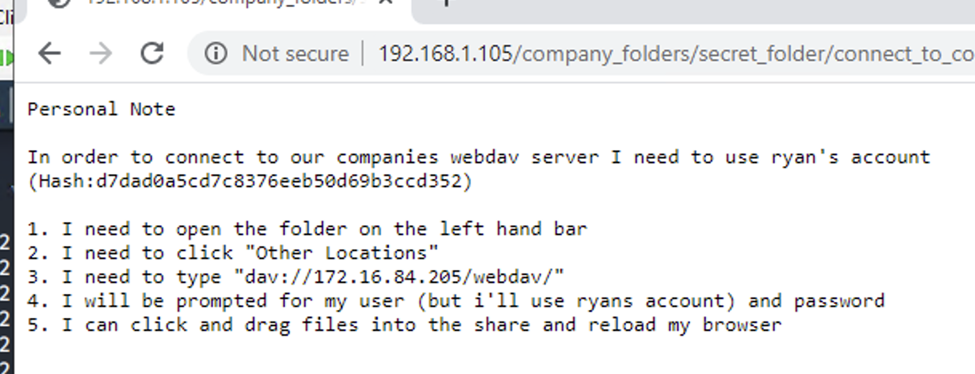
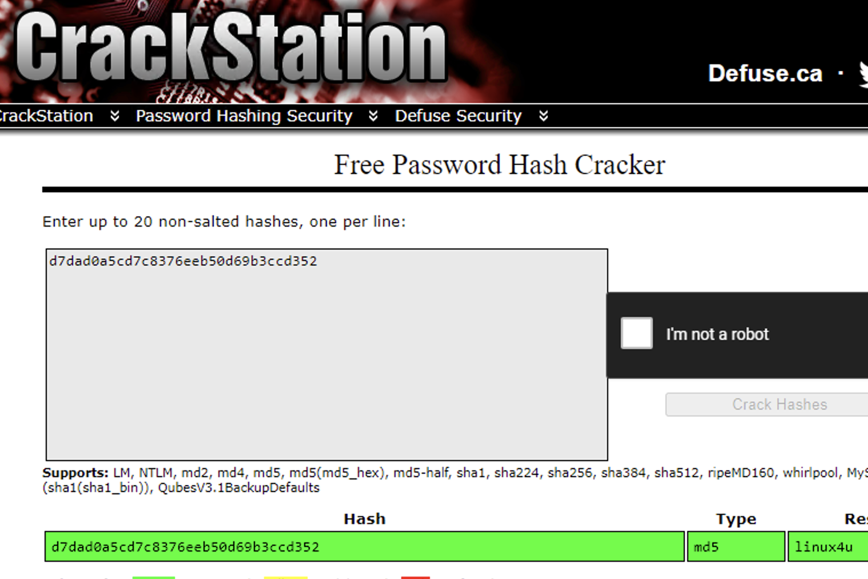
Exploitation: [Hidden Folder unauthorized access]
01
02
03
Tools & Processes
Tools: Web Browser, Hydra, Crackstation
Use web browser to obtain information from files within /meet_our_team/ and shows there is a secret_folder that can be access by Ashton
Use Hydra to obtain the password of Ashton
Use Crackstation to obtain Ryan’s password from hashes inside secret folder
Achievements
Able to reveal there is a hidden folder inside company_folders and then
Obtain Ashton’s password of Ashton and get access to the secret_folder
Obtain Ryan’s password and reveal the access information of WebDav folder

Slide 10
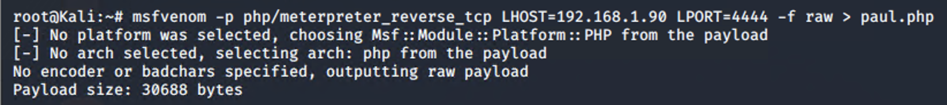
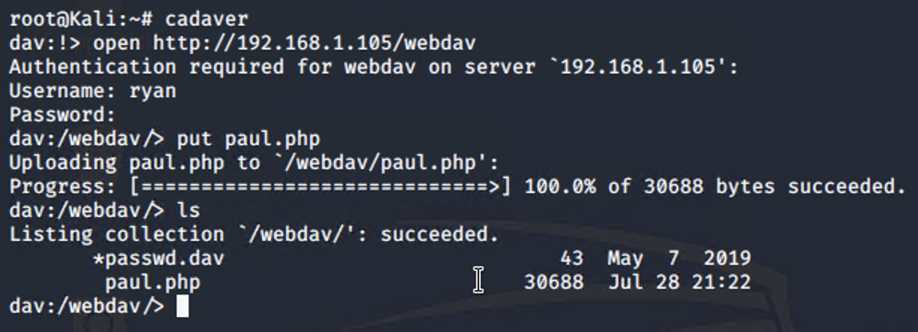
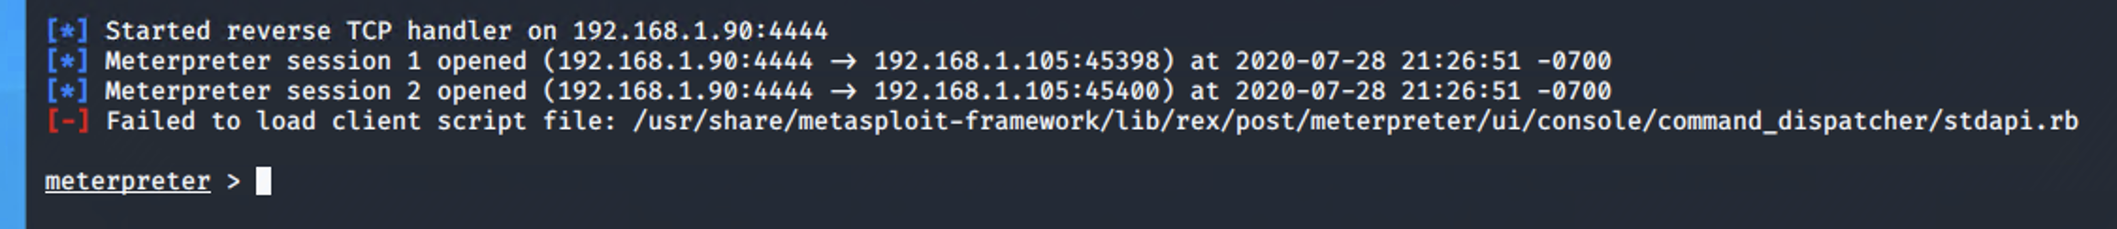
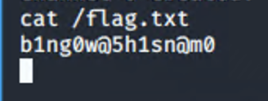
Exploitation: [WebDav Reverse Shell Attack]
01
02
03
Tools & Processes
msfvenom: create a custom script for the reverse shell attack
cadaver: Use to upload customed php script to webdav folder
msfconsole: Perform a reverse shell attack
Achievements
Able to run customized script paul.php and let the pentester run meterpreter script to locate and obtain the flag.txt from root folder

Slide 11

Blue Team
Log Analysis and Attack Characterization
11

Slide 12
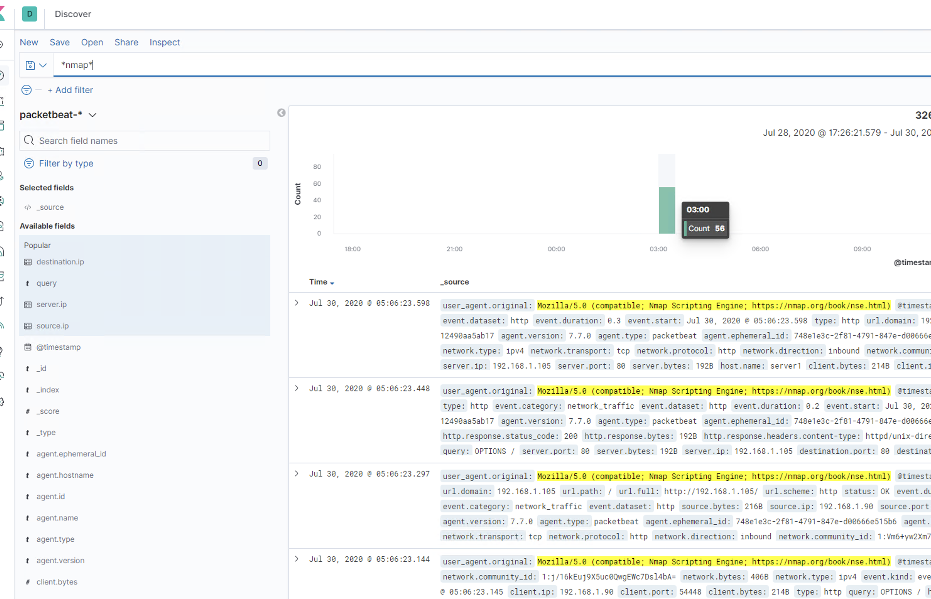
Analysis: Identifying the Port Scan
The port scan occurred at 3:29 am on 7/29/2020
There were 56 packets were sent, and from 192.168.1.90
The user agent shows it is from nmap

Slide 13
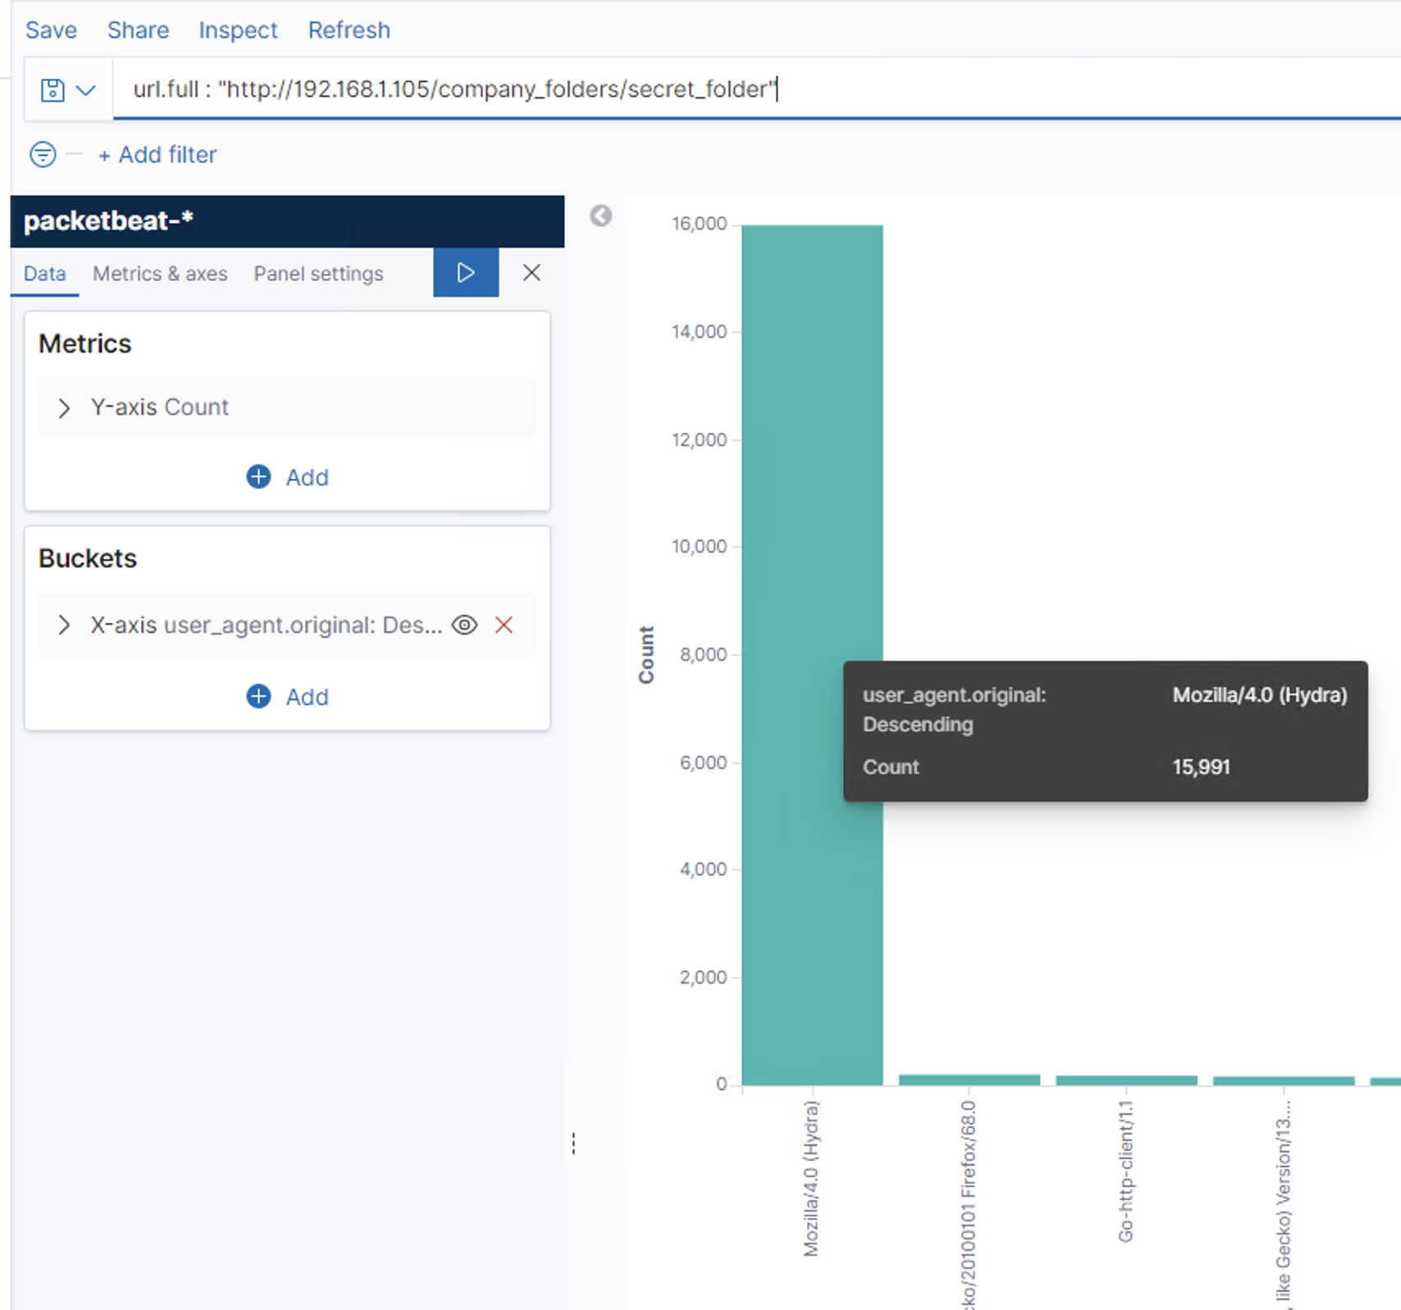
Analysis: Finding the Request for the Hidden Directory
The request occurred at 22:26 PM on July 29, 2020. And there are 15991 requests are made.
It was requesting connect_to_corp_server file inside the secret_folder

Slide 14
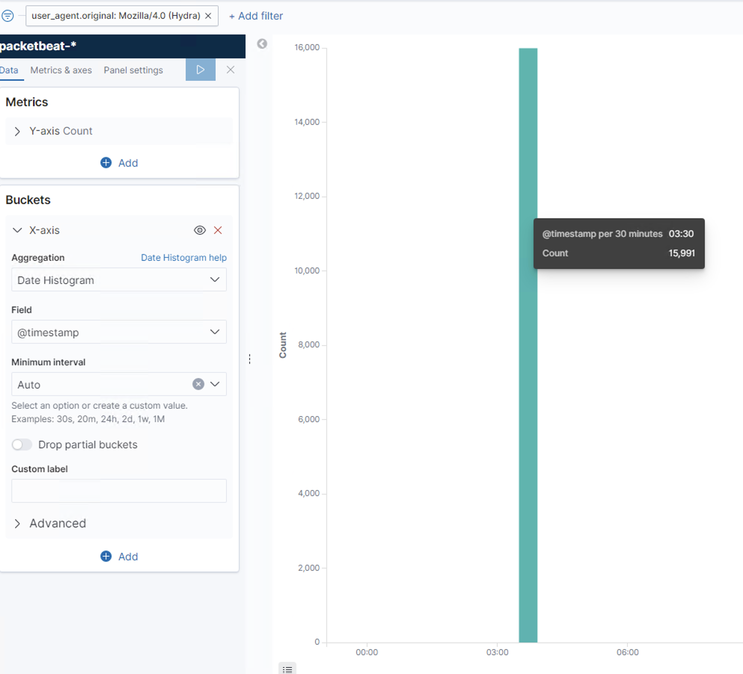

Analysis: Uncovering the Brute Force Attack
There were 15991 requests were made in the attack.
There were 15990 requests had been made before the attacker discovered the password.

Slide 15
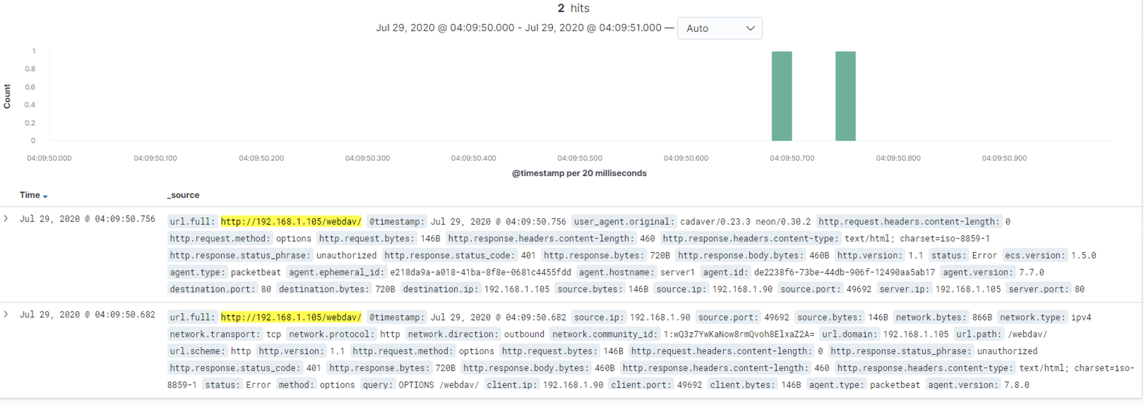
Analysis: Finding the WebDAV Connection
There were 2 requests were made to this directory.
It was requested the paul.php which is the reverse shell php inside the webdav folder

Slide 16
Blue Team
Proposed Alarms and Mitigation Strategies
16

Slide 17
Mitigation: Blocking the Port Scan
What kind of alarm can be set to detect future port scans?
Detect Nmap user agent
What threshold would you set to activate this alarm?
Any source ip with nmap user agent detected more than 1000 times in 30 mins
What configurations can be set on the host to mitigate port scans?
Firewall rules to detect user agent

Slide 18
Mitigation: Finding the Request for the Hidden Directory
What kind of alarm can be set to detect future unauthorized access?
url path = hidden directory besides whitelisted ip
What threshold would you set to activate this alarm?
Any ip is not whitelisted ip AND
URL path is hidden directory
More than 2000 times in 30 minutes
What configuration can be set on the host to block unwanted access?
Set allow ip address for specific folder access

Slide 19
Mitigation: Preventing Brute Force Attacks
What kind of alarm can be set to detect future brute force attacks?
Detect user agent original is Hydra
What threshold would you set to activate this alarm?
Any source ip with user agent is Hydra
What configuration can be set on the host to block brute force attacks?
Use of user certificate
Captcha
Multiple user authentication

Slide 20
Mitigation: Detecting the WebDAV Connection
What kind of alarm can be set to detect future access to this directory?
Detect URL path is WebDav AND
IP address is not whitelisted ip
What threshold would you set to activate this alarm?
If URL path contains webdav and source up is not whitelisted ip
What configuration can be set on the host to control access?
Use of SSL certificate
Multiple Factor Authentication
Use of IP and domain filtering
Prevent File execution
Use Request filtering to block certain type of file extension
Use of stateful firewall

Slide 21
Mitigation: Identifying Reverse Shell Uploads
What kind of alarm can be set to detect future file uploads?
When http method is PUT and source ip is unknown ip addresses.
What threshold would you set to activate this alarm?
What configuration can be set on the host to block file uploads?
impose strict control of outgoing connections

